Slide 1
POWER OF Algorithm Activity
Topic: Minimum Spanning Tree for Prim’s Algorithm.
Members: Sumant Reddy.
Satish Yadav.

Slide 2
SPANNING TREE AND MINIMUM spanning tREE.
Spanning tree
A spanning tree is a sub-graph of an undirected connected graph, which includes all the vertices of the graph with a minimum possible number of edges.
Minimum spanning tree
A minimum spanning tree (MST) is defined as a spanning tree that has the minimum weight among all the possible spanning trees.

Slide 3
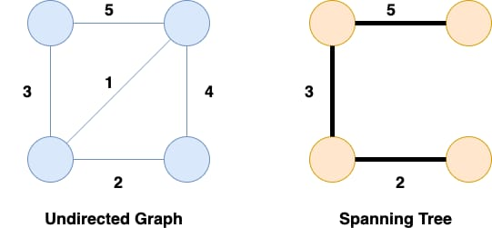
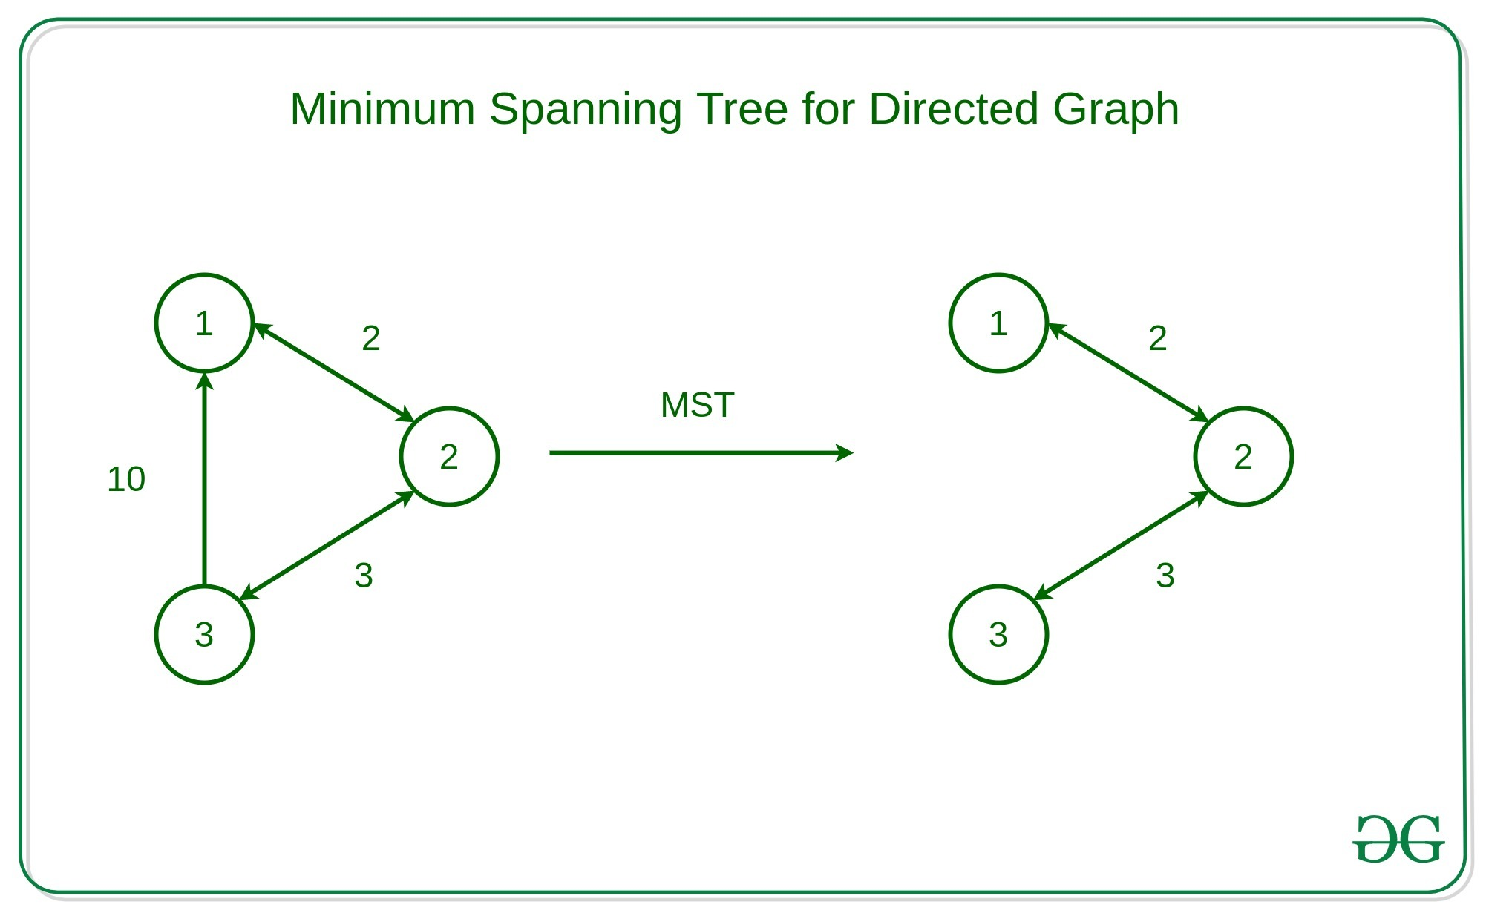
Spanning tree
Minimum spanning tree.

Slide 4
Prim’s algorithm.
Prim’s Algorithm is a greedy algorithm that is used to find the minimum spanning tree from a graph. Prim’s algorithm finds the subset of edges that includes every vertex of the graph such that the sum of the weights of the edges can be minimized.

Slide 5
Working of Prim’s AlgoritHM.
Prim’s Algorithm starts with the single node and explores all the adjacent nodes with all the connecting edges at every step. The edges with the minimal weights causing no cycles in the graph got selected.

Slide 6
Applications of Prim’s Algorithm.
Prim’s Algorithm can be used in network designing.
It can be used to make network cycles.
It can be used to lay down electrical wiring cables.

Slide 7
.
THANK YOU.

